Slide 1


Zend PHP 5.3 Certification Demo
40 questions in 40 minutes
Enrico Zimuel (enrico.z@zend.com)
Carlos Buenosvinos (carlos@quepimquepam.com)

Slide 2
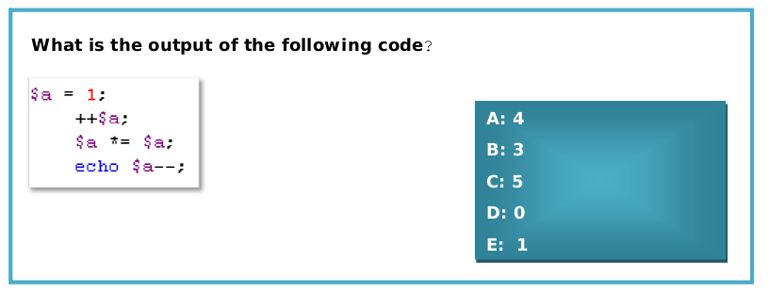
Question 1

Slide 3
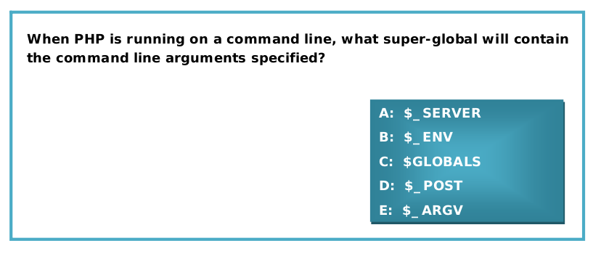
Question 2

Slide 4
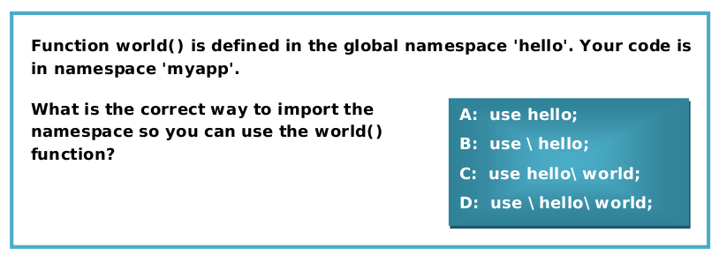
Question 3

Slide 5
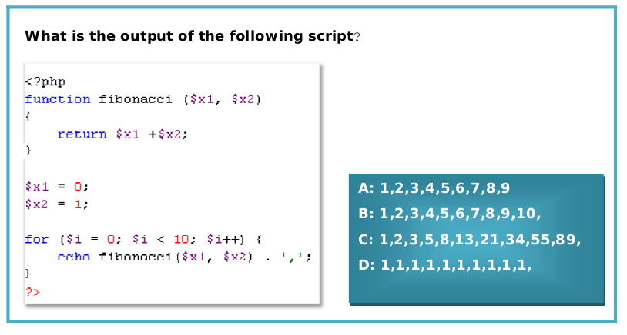
Question 4

Slide 6
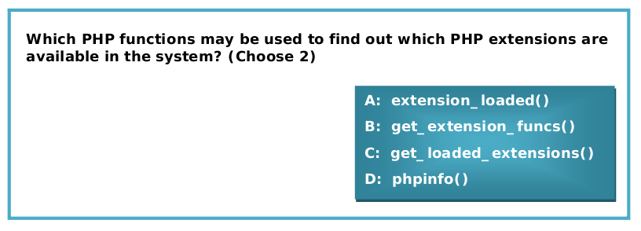
Question 5

Slide 7
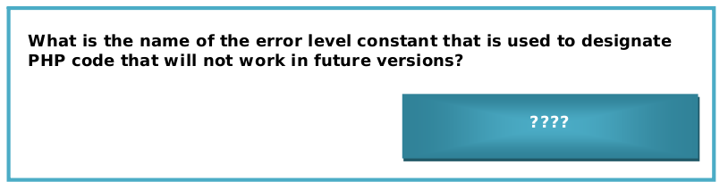
Question 6

Slide 8
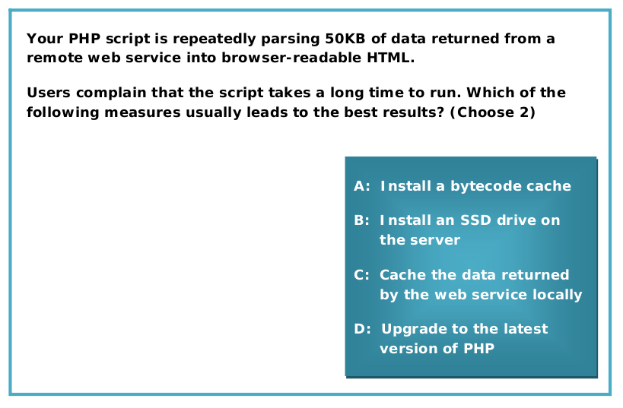
Question 7

Slide 9
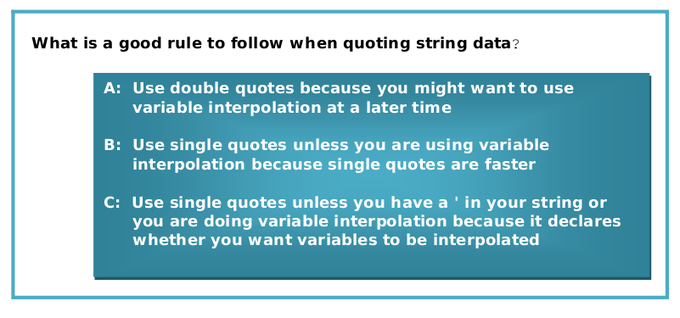
Question 8

Slide 10
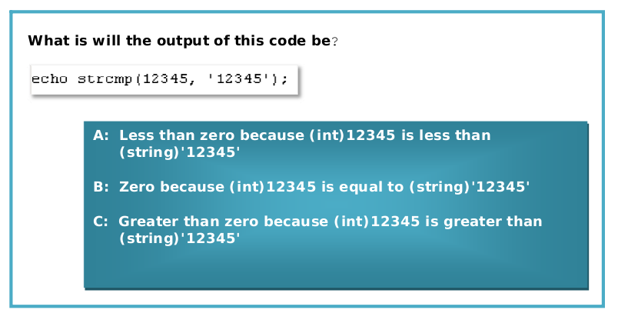
Question 9

Slide 11
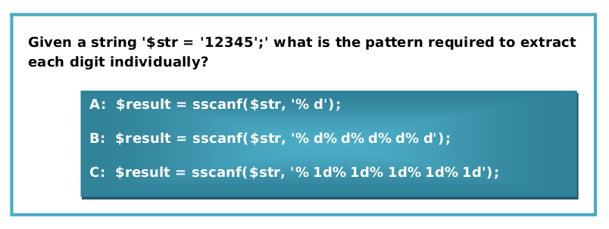
Question 10

Slide 12
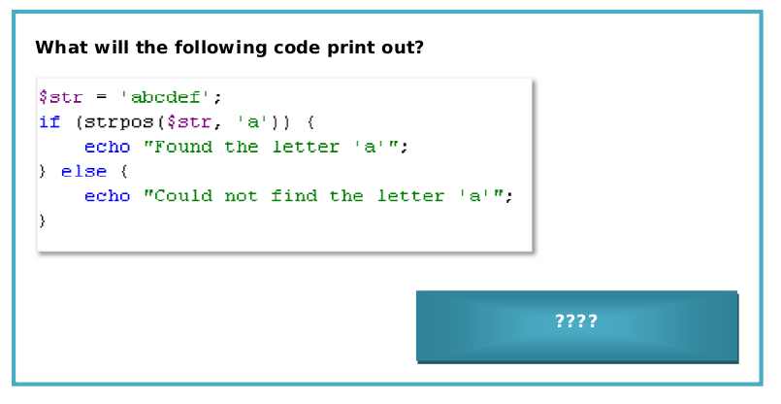
Question 11

Slide 13
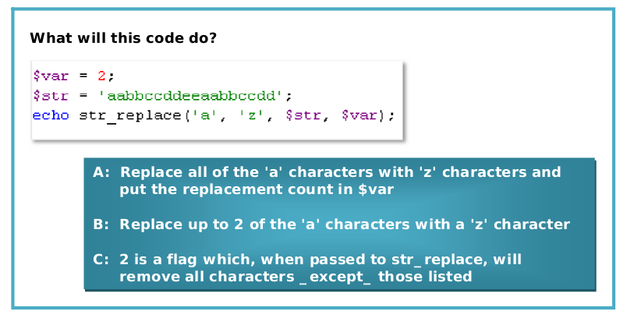
Question 12

Slide 14
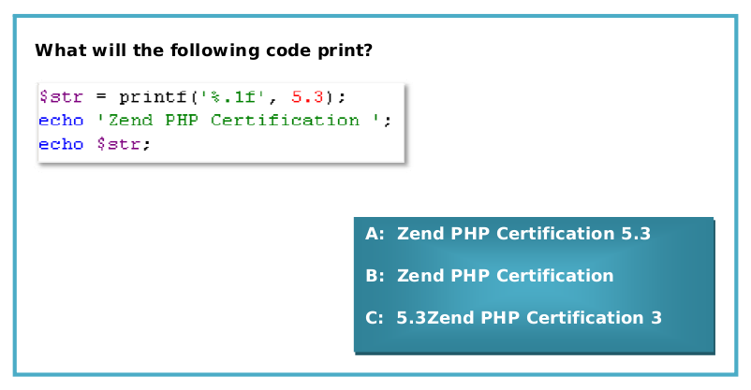
Question 13

Slide 15
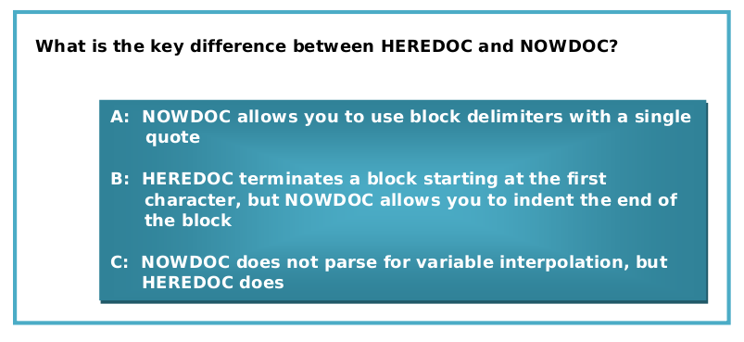
Question 14

Slide 16
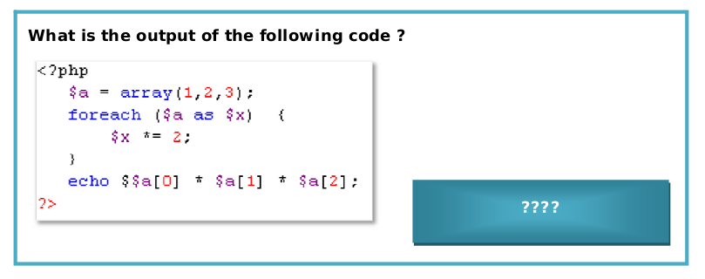
Question 15

Slide 17
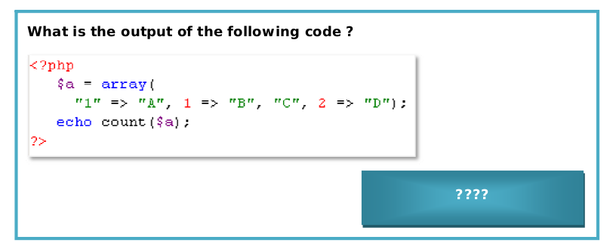
Question 16

Slide 18
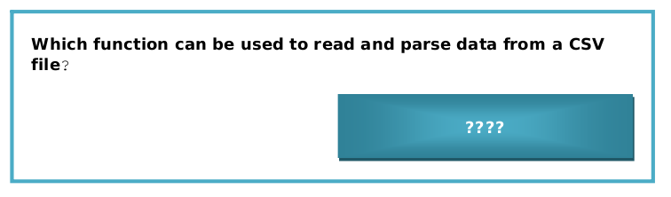
Question 17

Slide 19
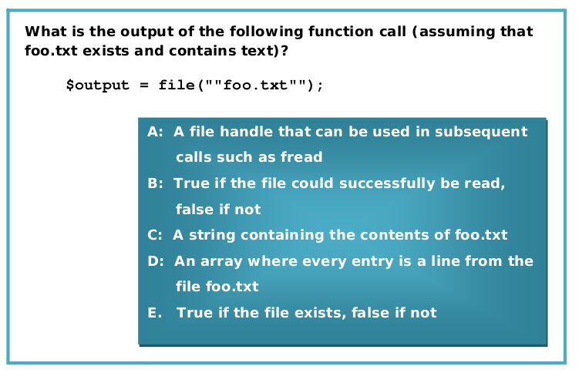
Question 18

Slide 20
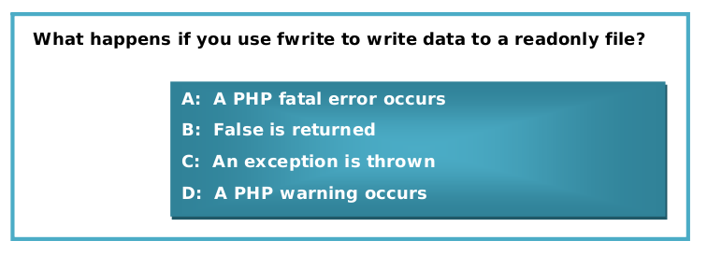
Question 19

Slide 21
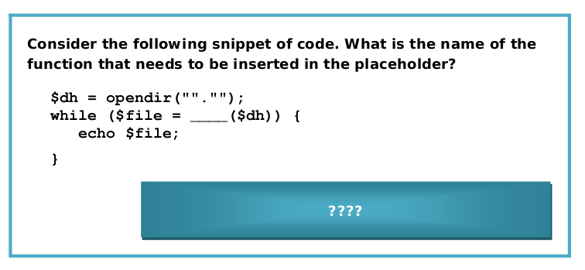
Question 20

Slide 22
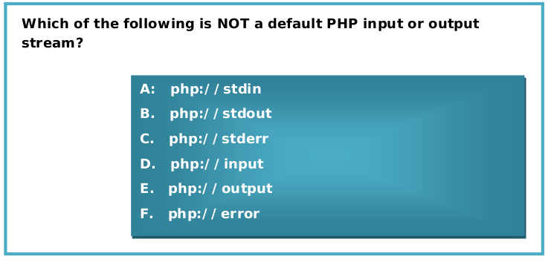
Question 21

Slide 23
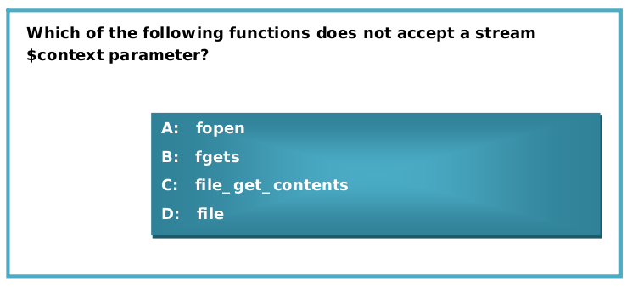
Question 22

Slide 24
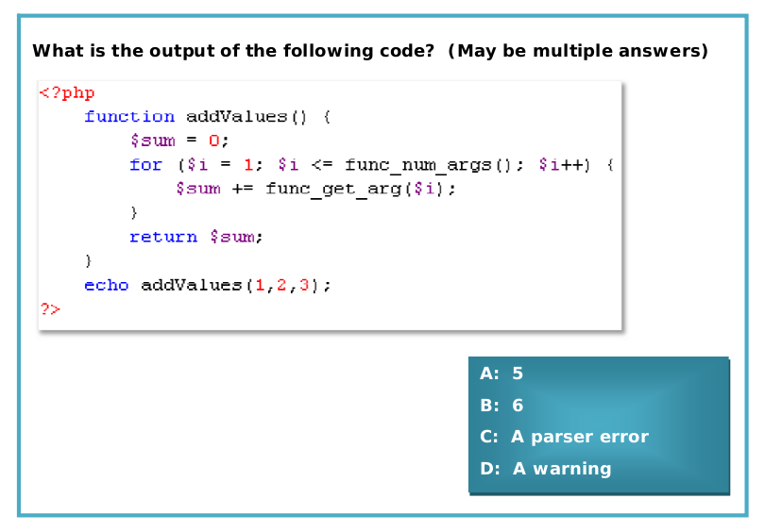
Question 23

Slide 25
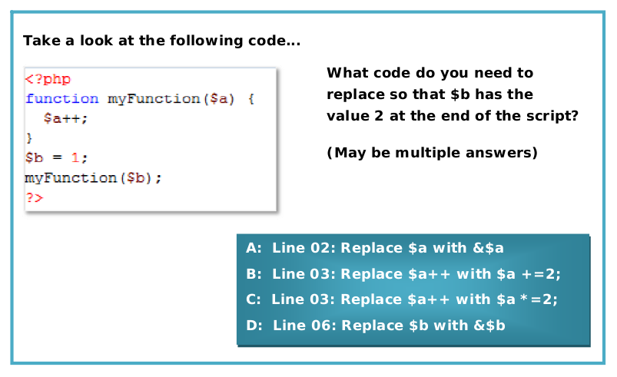
Question 24

Slide 26
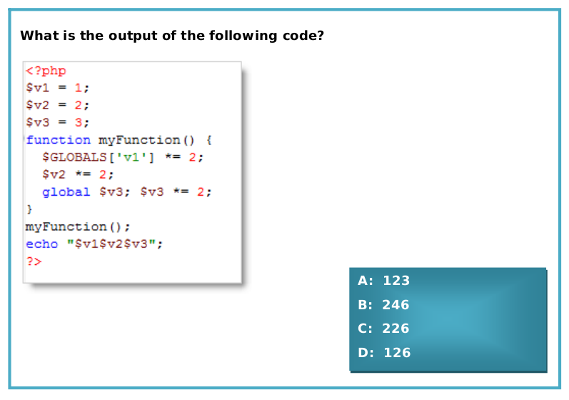
Question 25

Slide 27
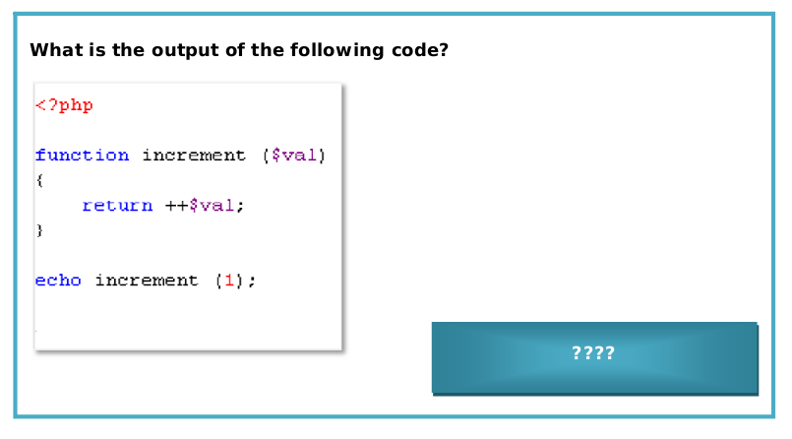
Question 26

Slide 28
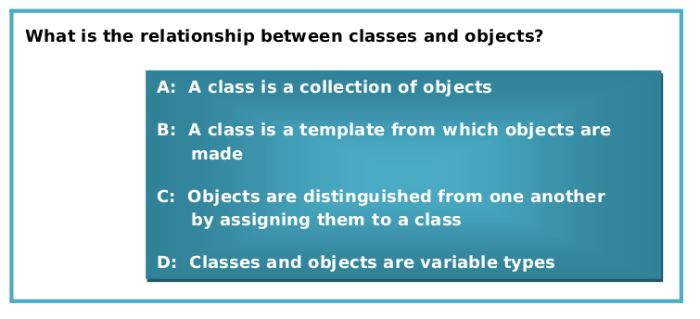
Question 27

Slide 29
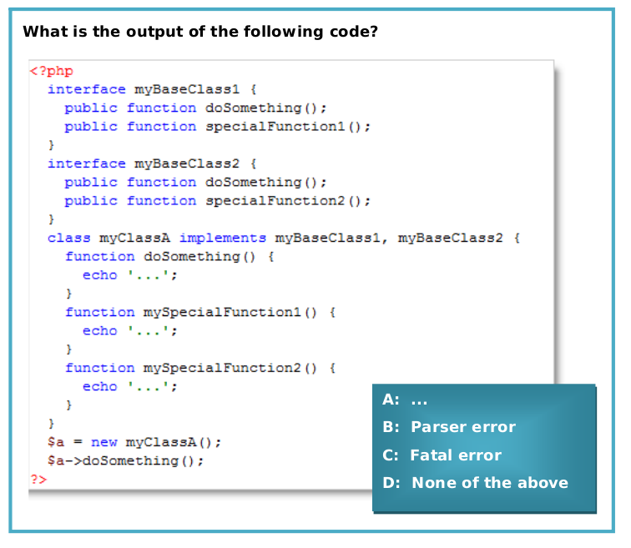
Question 28

Slide 30
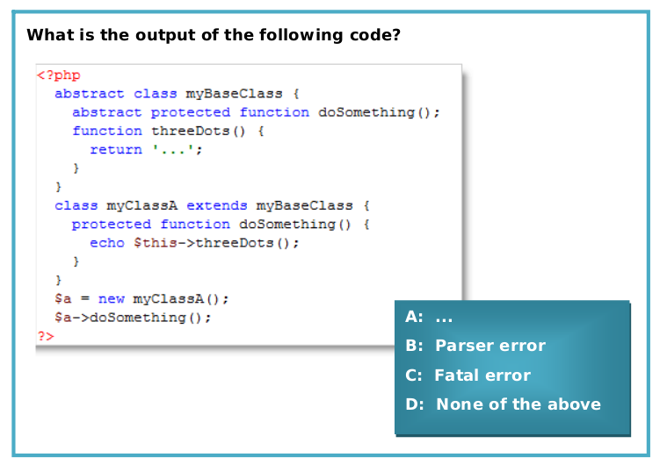
Question 29

Slide 31
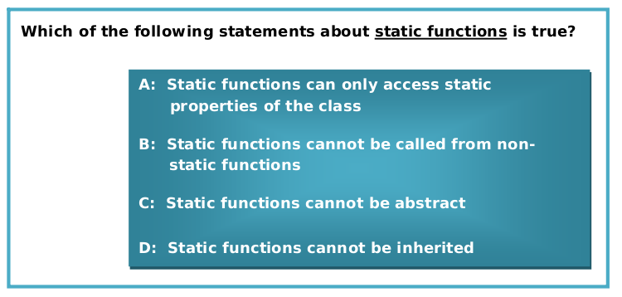
Question 30

Slide 32
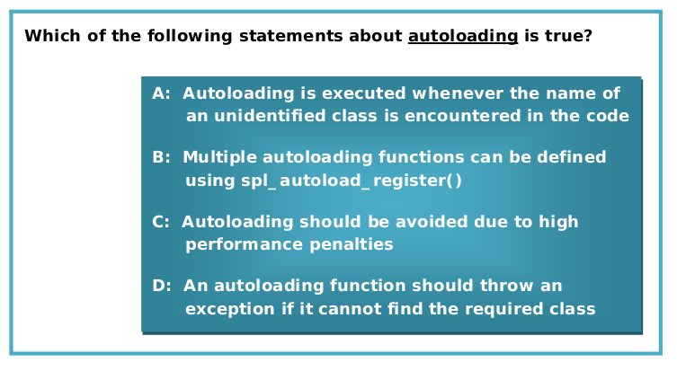
Question 31

Slide 33
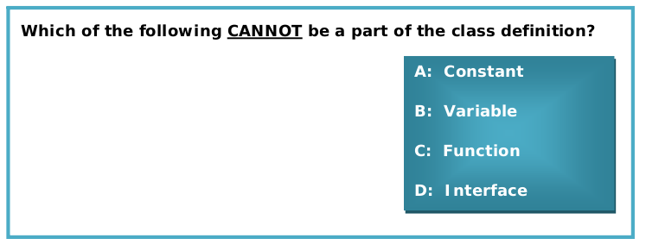
Question 32

Slide 34
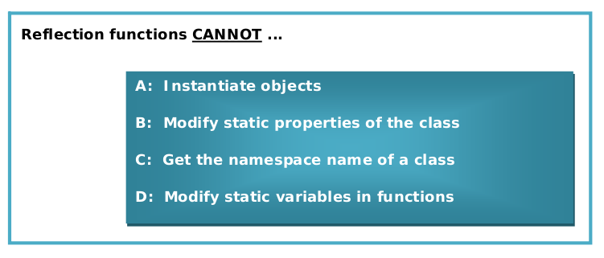
Question 33

Slide 35
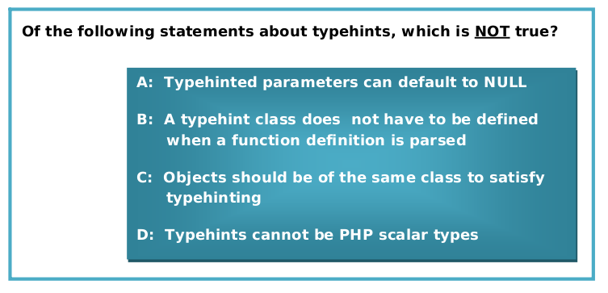
Question 34

Slide 36
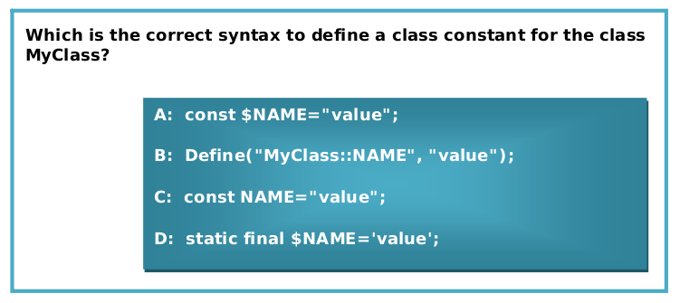
Question 35

Slide 37
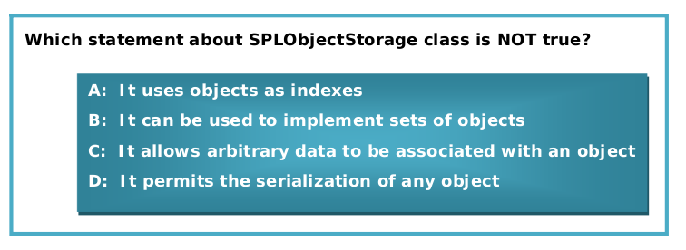
Question 36

Slide 38
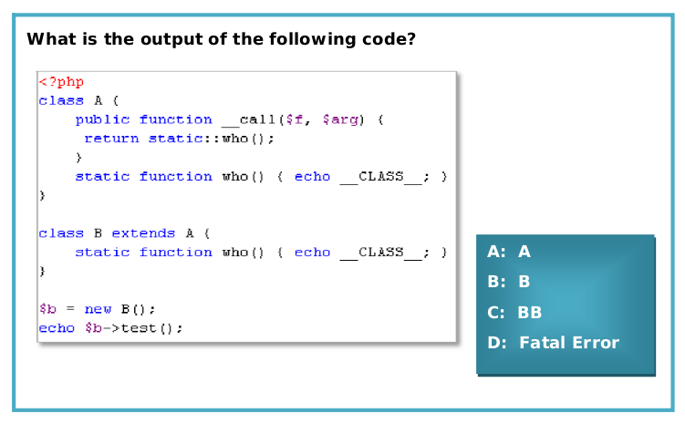
Question 37

Slide 39
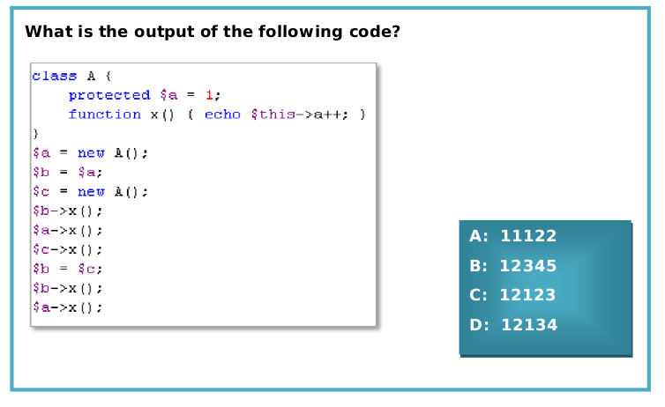
Question 38

Slide 40
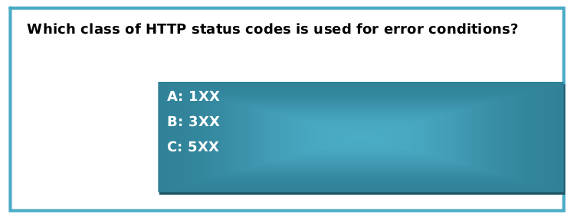
Question 39

Slide 41
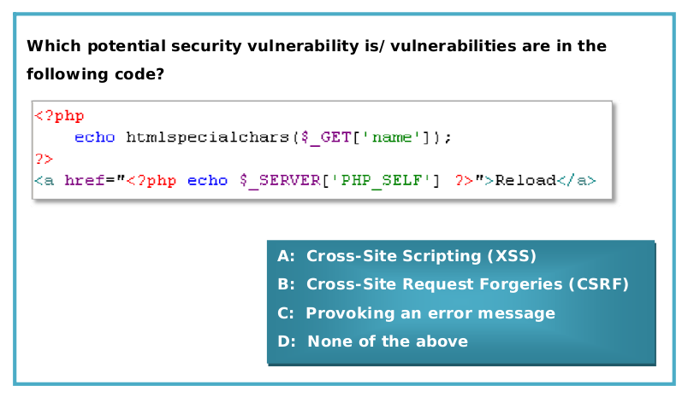
Question 40

Slide 42
Results
If you answered right at least 24 questions you have a good probability to pass the Zend PHP 5.3 Certification Exam.
If not don't worry, let's try anyway, this is not the real exam.
Good Luck!
More info: http://www.zend.com

